Slide 1


Formulation And In-Vitro Evaluation Of Fesoterodine Fumarate Loaded Microbeads By Ion Gelation Method
Submitted to
Faculty of Pharmacy
Osmania University
Hyderabad.
Presented by
G. Sathvika (1704-19-881-021)
P. Divya Jyothi (1704-19-881-059)
S. Cherishma (1704-19-881-066)
S. Saisnehanjali (1704-19-881-067)
under the guidance of
Smt. G. Sri Lalitha,M. Pharm, (Ph.D)
Assistant Professor,
Department of Pharmaceutics
SAROJINI NAIDU VANITA PHARMACY
MAHA VIDYALAYA
Tarnaka , Secunderabad -2023

Slide 2
CONTENTS
Abstract
Aim & Objectives
Introduction
Literature review
Plan of work
Need of work
Materials & Methods
Evaluation tests
Results and Discussion
Conclusion
References

Slide 3
ABSTRACT
The aim of the project is to Formulation and In-Vitro Evaluation Of Fesoterodine Fumarate Loaded Microbeads by Ion Gelation Method to facilitate sustained release action to treat Overactive Bladder Disease (OBD). The gel beads were made by gently combining or homogenizing an oil and water phase containing sodium alginate, which was then extruded into a calcium chloride solution to create gel beads. The gel beads contained various amounts of egg albumin, HPMC, and tween-80. The effects of types of egg albumin, HPMC, and their proportions, on the morphology and release characteristics, were optimized. At different proportions of polymers were used to study the effect on the sustaining property of the formed beads. The drug-entrapped sodium alginate gel beads showed sustained release. Among different formulations, the combination of HPMC, egg albumin, and sodium alginate with different concentrations of and have 98% of drug release and F4 considered as optimized formulation.
Key Words: Fesoterodine Fumarate, Ion Gelation Method, OBD,HPMC

Slide 4
AIM
The aim of the project is Formulation and In-Vitro Evaluation Of Fesoterodine Fumarate Loaded Microbeads by Ion Gelation Method to facilitate sustained release action to treat Overactive Bladder Disease (OBD).
OBJECTIVES:
• To prepare microbeads with good absorptive properties.
• To conduct in-vitro studies by using the Type-I Dissolution apparatus.(Basket type)
• Choosing and optimizing the production process.
• To investigate the impact of polymer concentration on Fesoterodine Fumarate and to find the optimal polymer.
• To evaluate the prepared microbeads as per pharmacopeial standards.
• To Develop analytical methods and conduct drug-polymer interaction investigations by FT-IR Spectral studies.

Slide 5
INTRODUCTION
Beads are one of the most commonly used techniques in a sustained-release dosage form.
These are spherical particles with a size ranging from 50 nm to 200 mm, which contain core substances.
The sustained-release beads are the spherical substances that contain the active pharmaceutical ingredient and are designed to release the drug at a predetermined rate at a constant concentration in the body.
Overactive Bladder Disease (OBD) is a common condition where there is a frequent urge to urinate. If there is a loss of bladder count then it is known as urge incontinence.
Muscarinic receptors have long been the target receptors for the treatment of patients with overactive bladder (OBD).
Fesoterodine, a pro-drug, structurally and functionally related to tolterodine, is the newest agent developed for the treatment of OBD.

Slide 6
ADVANTAGES
DISADVANTAGES
Ideal pharmacokinetic properties.
Enhance homogenous deviation in the body.
Minimum dose variation in the combinations of API & less dose-dumping; separate the protect the active ingredients to give better compatibility.
The new system with an increased duration of action.
Decrease dosing frequency
Improve patient compliance
Reducing side effects
Compared to another formulation cost of this system is much higher.
The use of synthetic polymer gives it an impact on the environment.
The other component of the system plays a hazardous role in certain areas of human life.
Reproducibility of preparation is minimal.
The degradation substance of the repeating unit is produced

Slide 7
API PROFILE
Molecular formula: C₂₆H₃₇NO₃
Molecular weight: Average: 411.5769,
Brand name: Toviaz tablets
Category: Antimuscarinic
IUPAC Name: 2- [ (1R)-3- [bis (propan-2-yl) amino]-1-phenylpropyl]-4- (hydroxymethyl)phenyl 2-methyl propanoate
Bioavailability: 5-HMT = 28%
Metabolism: Liver
Half-life: 7-8 hours
Mechanism of action: Fesoterodine, once converted to its active metabolite, 5-hydroxymethyl tolterodine, acts as a competitive antagonist at muscarinic receptors. This results in the inhibition of bladder contraction, a decrease in detrusor pressure, and incomplete emptying of the bladder.

Slide 8
LITERATURE REVIEW
Kanchan Gupta et al., (2010) This review suggested providing an overview of the mechanism of action of and clinical trial data for Fesoterodine Fumarate, and discuss the present status of Fesoterodine in the management of OAB.
Bilal Chughtai et al., (2015) This article discusses the efficacy of long-acting fesoterodine on persistent lower urinary tract symptoms in men who have had previous surgical treatment for Bladder Outlet Obstruction (BOO).
Shizuo Yamada et al., (2019) The present study aimed to characterize the muscarinic receptor binding of fesoterodine, 5-hydroxymethyl tolterodine (5-HMT), and tolterodine in the bladder and other tissues of rats after their oral, intravenous, or intravesical administration.
Maria Tzefos et al., (2009) This article suggests pharmacologic, pharmacokinetic, efficacy, and safety data for fesoterodine and determines its role in the treatment of overactive bladder. Fesoterodine appears to be effective and generally safe for the treatment of overactive bladder.
Kylie J Mansfield et al., (2009) This review article identifies that Muscarinic receptors have long been the target receptors for the treatment of patients with overactive bladder (OAB).

Slide 9
PLAN OF WORK
1. Selection of drug- depends on dosage, solubility, lipophilicity
2. Polymer selection- depends on drug-excipient compatibility, solubility
3. Preparation of microbeads for Fesoterodine Fumarate with polymers
4. Evaluation of sustained release microbeads
• Bead size measurement
• Swelling Index
• In-vitro dissolution studies
• Fourier Transform Infra-Red Spectroscopy
• Drug Content of the beads

Slide 10
NEED OF WORK
A number of conventional pharmaceutical dosage forms are available, but their bioavailability is not up to the mark.
In order to increase bioavailability and to improve other pharmacokinetic parameters, Formulation and In-Vitro Evaluation of Fesoterodine Fumarate Loaded Microbeads By Ion Gelation Method
Issues like dissolution rate are improved when the drug is incorporated into Microbeads.
Stability, the therapeutic efficacy of the drug will be increased in the form of Microbeads.
Recent trends in pharmaceutical technology indicate that alginate beads as drug delivery systems are especially suitable for achieving delivery of drugs at a predetermined rate locally or systemically for a prolonged period
The sustained release system has more therapeutic activity of a drug when compared to immediate release.

Slide 11
METHOD OF PREPARATION OF MICROBEADS
ION GELATION METHOD:
Accurately weigh about 9% sodium alginate and egg albumin 10% of egg albumin and kept aside, then it was dispersed in 100ml of distilled water by using a magnetic stirrer at 40ºc.
Then after complete dispersion added and accurately 8mg of Fesoterodine Fumarate then the stirring was continued until a complete and uniform dispersion was obtained.
Then the calcium chloride solution was prepared by dispersing the 10gm of calcium chloride powder in 100ml of distilled water.
The resulting bubble-free dispersion was added manually dropwise with a 5ml syringe (22 gauze needle) into 100ml of(10%w/v) calcium chloride solution (CaCl2) and stirred in a 250ml beaker.
The gelation time of 15min was allowed to complete the curing reaction and produces spherical and rigid microbeads. The beads so prepared were collected by decantation and washed with water and dried in a hot air oven at 60 ºc for 2 hours.
The process was applied to 7 different formulations by using varying proportions of egg albumin and sodium alginate (i.e., F2-F8)

Slide 12
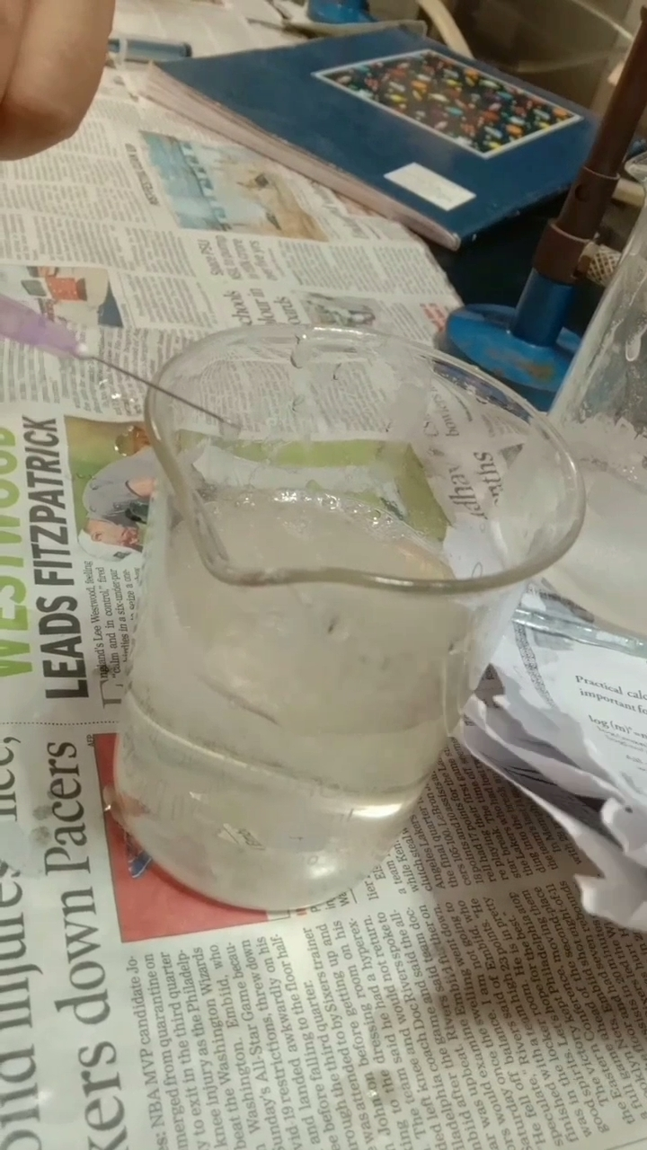
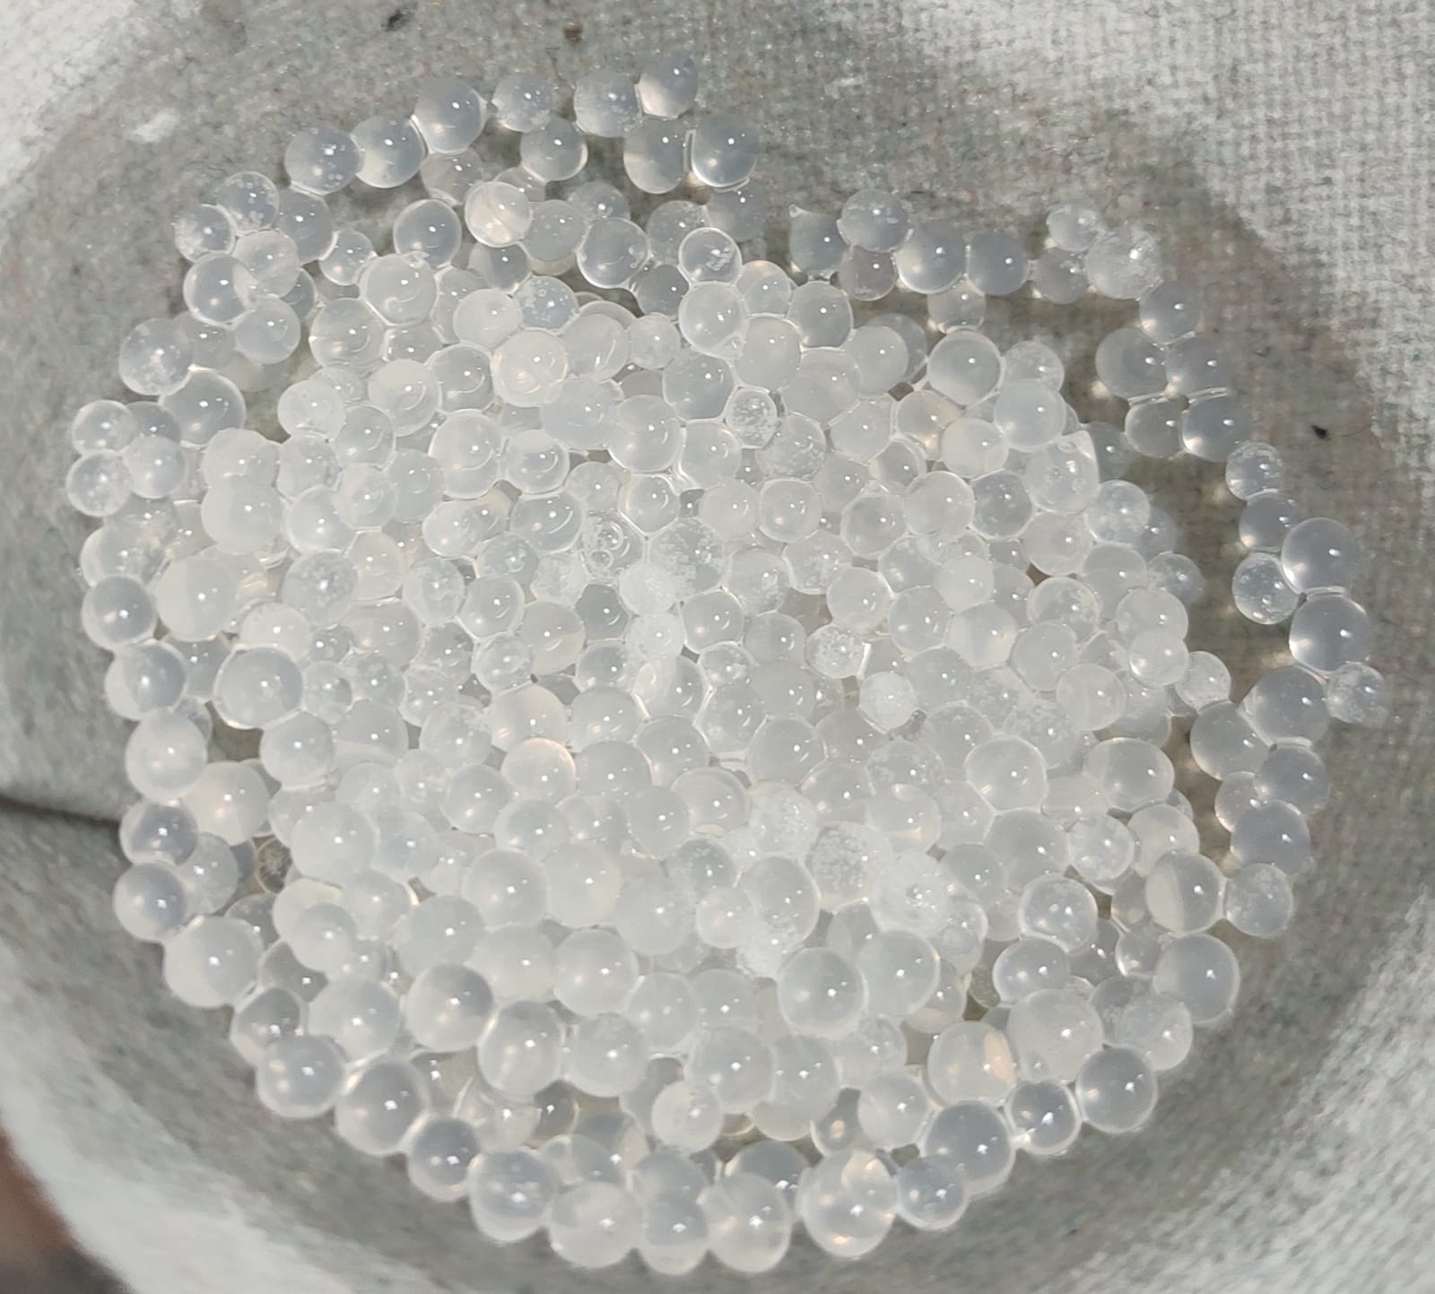
Preparation of Microbeads by using a syringe needle and recovery of microbeads after decantation.

Slide 13
METHODOLOGY FORMULATION TABLE
S. No | Formulation Code | API Fesoterodine Fumarate ( mg) | Egg Albumin | Sodium Alginate (% w/v) | HPMC (mg) | Tween 80 (ml) | Water | Calcium chloride (% w/v)
1 | F1 | 8 | 10 | 1 | 2 | 0.4 | q.s | 10
2 | F2 | 8 | 20 | 3 | 4 | 0 | q.s | 10
3 | F3 | 8 | 10 | 5 | 2 | 0.4 | q. s | 10
4 | F4 | 8 | 20 | 7 | 4 | 0 | q. s | 10
5 | F5 | 8 | 10 | 9 | 2 | 0.4 | q. s | 10
6 | F6 | 8 | 20 | 11 | 4 | 0 | q. s | 10
7 | F7 | 8 | 10 | 13 | 2 | 0.4 | q. s | 10
8 | F8 | 8 | 20 | 15 | 4 | 0 | q. s | 10

Slide 14
EVALUATION TESTS
Fourier Transform Infra-Red Spectroscopy
Bead size measurement
Swelling Index
Drug Content of the beads
In-vitro dissolution studies

Slide 15
EVALUATION PARAMETERS
Formulation Code | Drug Content | Swelling Index | Size Distribution
F1 | 93 | 32.2 | 110
F2 | 91 | 43 | 123
F3 | 92 | 58 | 136
F4 | 98 | 94 | 83
F5 | 95 | 68 | 136
F6 | 89 | 82 | 140
F7 | 97 | 79 | 128
F8 | 94 | 73 | 115

Slide 16
RESULTS AND DISCUSSION DEVELOPMENT OF CALIBRATION CURVE The absorbance for various concentrations measured at 222 nm as follows
S.No | Concentration (µg/ml) | Absorbance
1 | 0 | 0
2 | 5 | 0.181
3 | 10 | 0.362
4 | 15 | 0.543
5 | 20 | 0.712
6 | 25 | 0.867
Standard Calibration Table of Fesoterodine Fumarate in 6.8 pH Phosphate Buffer

Slide 17
Standard Calibration Graph of Fesoterodine Fumarate in 6.8 pH Phosphate buffer
Fesoterodine Fumarate shows good linearity with the range 0 to 25μg with R2= 0.999, Slope = 0.034 x

Slide 18
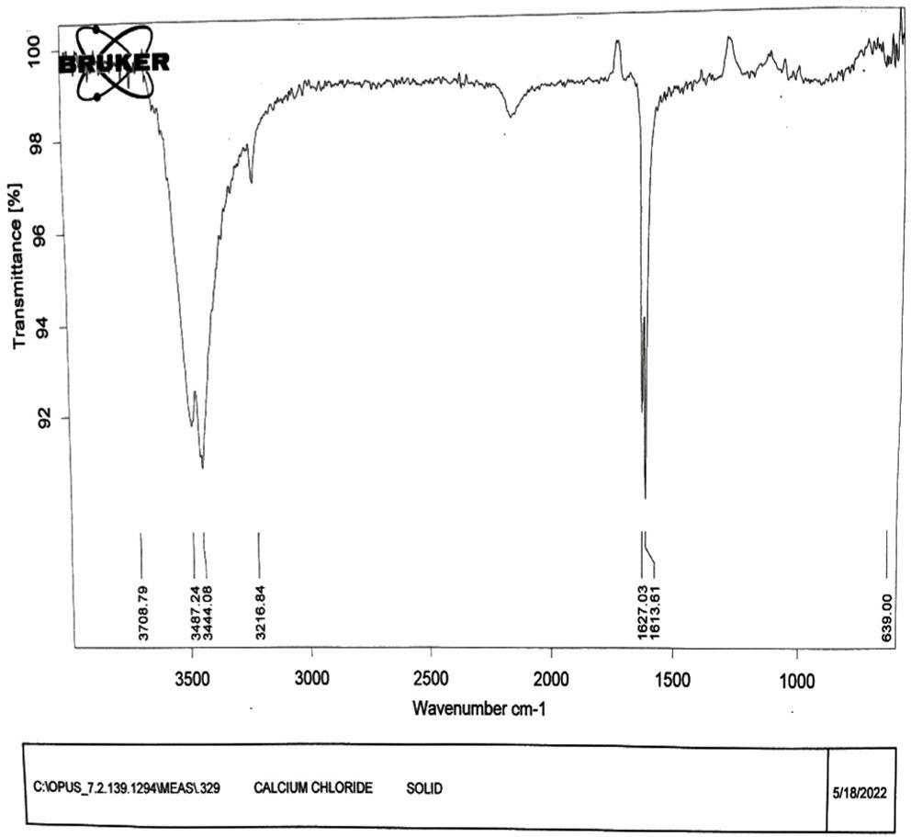
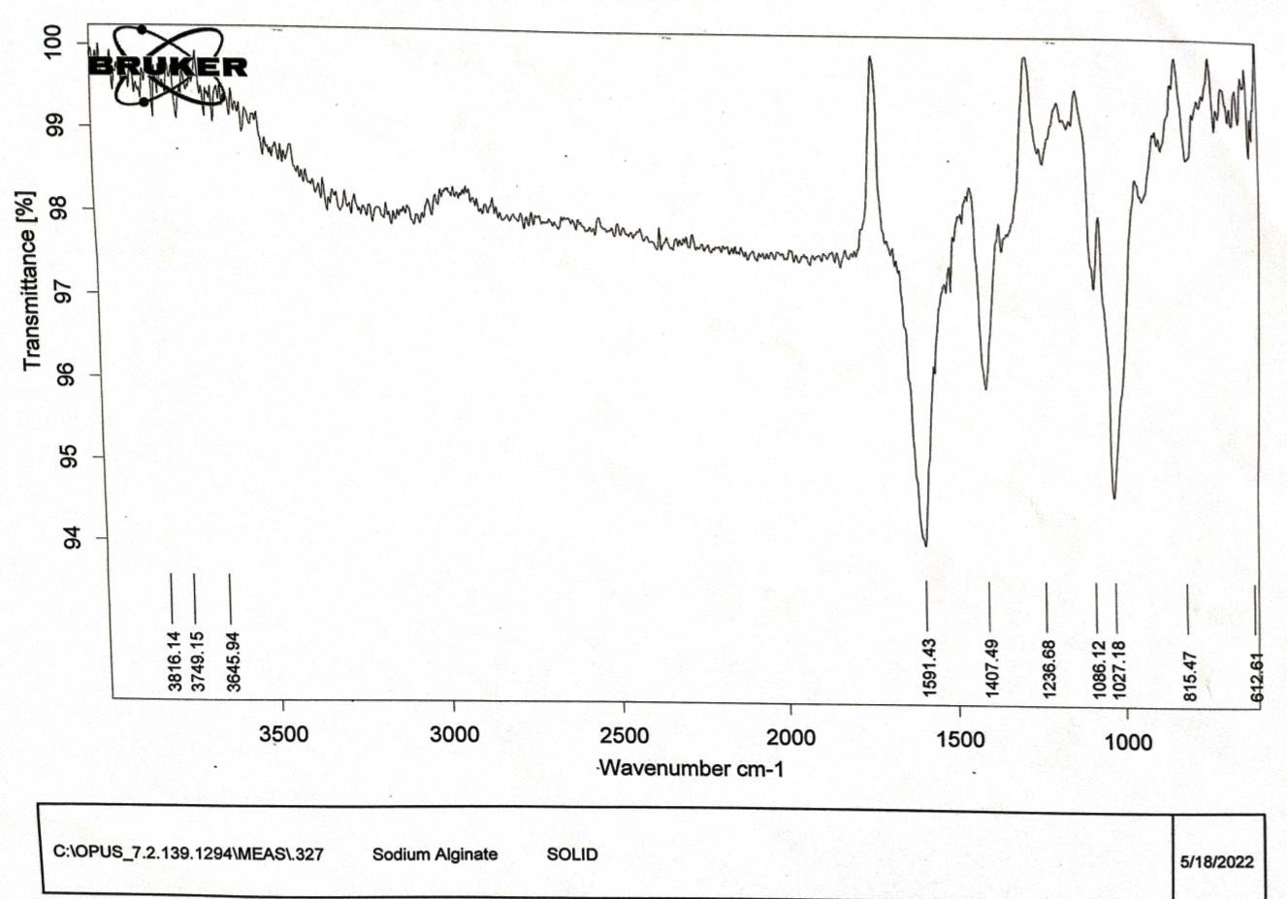
FT-IR STUDIES
FT-IR Spectrum of Calcium Chloride
FT-IR Spectrum of Sodium Alginate

Slide 19
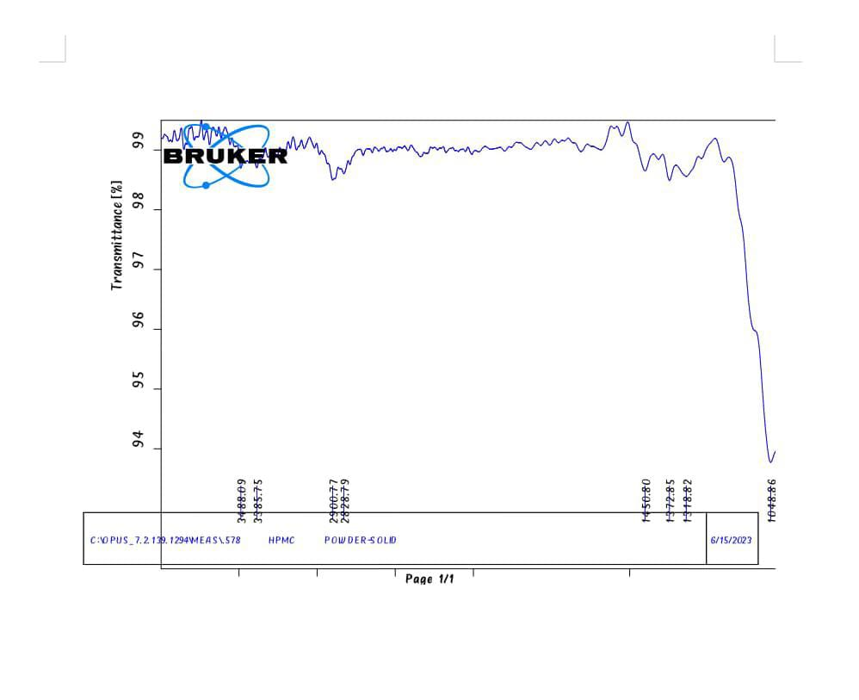
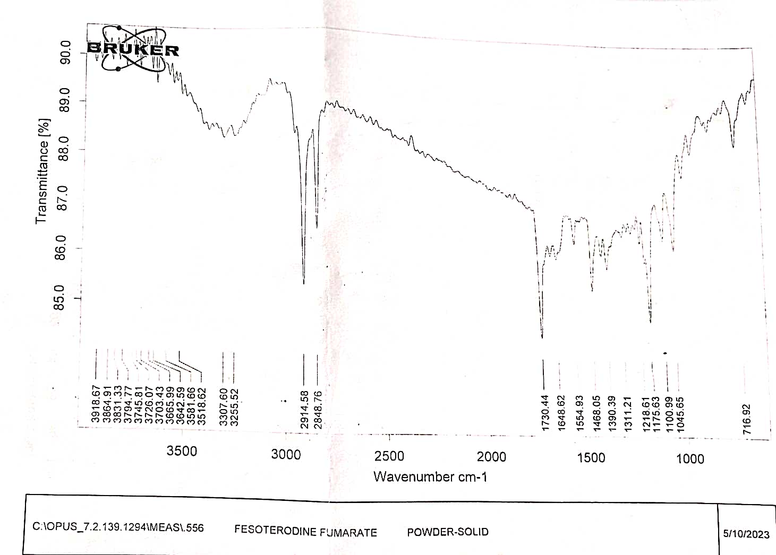
FT-IR Spectrum of HPMC
FT-IR Spectrum of
Fesoterodine Fumarate

Slide 20
FTIR spectra of Fesoterodine Fumarate pure drug display principal bands at a wave number as follows.
Functional Groups | Mode of Vibration | Wave number
O-H | Stretching | 2992.30
C=C | Stretching | 1659.53
C=O | Stretching | 1754.59 1722.79

Slide 21
CUMULATIVE % OF DRUG RELEASE (F1-F4)
Time (hrs) | F1 | F2 | F3 | F4
0 | 0 | 0 | 0 | 0
1 | 17 | 12 | 14 | 16
2 | 26 | 22 | 28 | 29
3 | 37 | 34 | 39 | 37
4 | 43 | 41 | 53 | 52
5 | 48 | 46 | 57 | 58
6 | 52 | 48 | 59 | 62
7 | 59 | 54 | 69 | 79
8 | 71 | 64 | 77 | 87
10 | 88 | 79 | 87 | 92
12 | 93 | 91 | 94 | 98

Slide 22
CUMULATIVE % OF DRUG RELEASE (F5-F8)
Time (hrs) | F5 | F6 | F7 | F8
0 | 0 | 0 | 0 | 0
1 | 13 | 15 | 14 | 11
2 | 18 | 24 | 25 | 19
3 | 26 | 36 | 31 | 28
4 | 39 | 44 | 45 | 37
5 | 43 | 47 | 48 | 43
6 | 54 | 52 | 54 | 49
7 | 57 | 55 | 57 | 53
8 | 69 | 72 | 77 | 63
10 | 76 | 89 | 84 | 75
12 | 88 | 95 | 90 | 82

Slide 23
CUMULATIVE % OF DRUG RELEASE (F1-F8)

Slide 24
RELEASE KINETICS STUDIES OF THE OPTIMIZED FORMULATION (F₄)
ZERO ORDER KINETICS
Time | Cumulative % Release
0 | 0
1 | 16
2 | 29
3 | 37
4 | 52
5 | 58
6 | 62
7 | 79
8 | 87
10 | 92
12 | 98
Zero-order plot for optimized formulation (F4)

Slide 25
HIGUCHI MODEL
Time | Square root of time | % drug release
0 | 0 | 0
1 | 1.000 | 16
2 | 1.414 | 29
3 | 1.732 | 37
4 | 2.000 | 52
5 | 2.236 | 58
6 | 2.449 | 62
7 | 2.646 | 79
8 | 2.828 | 87
10 | 3.162 | 92
12 | 3.464 | 98
Higuchi plot for optimized formulation (F4)

Slide 26
KORS-MEYER PEPPAS MODEL
Time | Log Time | Log % Drug Release
0 | 0 | 0
1 | 0.000 | 1.204
2 | 0.301 | 1.462
3 | 0.477 | 1.568
4 | 0.602 | 1.716
5 | 0.699 | 1.763
6 | 0.778 | 1.792
7 | 0.845 | 1.898
8 | 0.903 | 1.940
10 | 1.000 | 1.964
12 | 1.079 | 1.991
Korsemayer-Peppas plot for optimized formulation (F4)

Slide 27
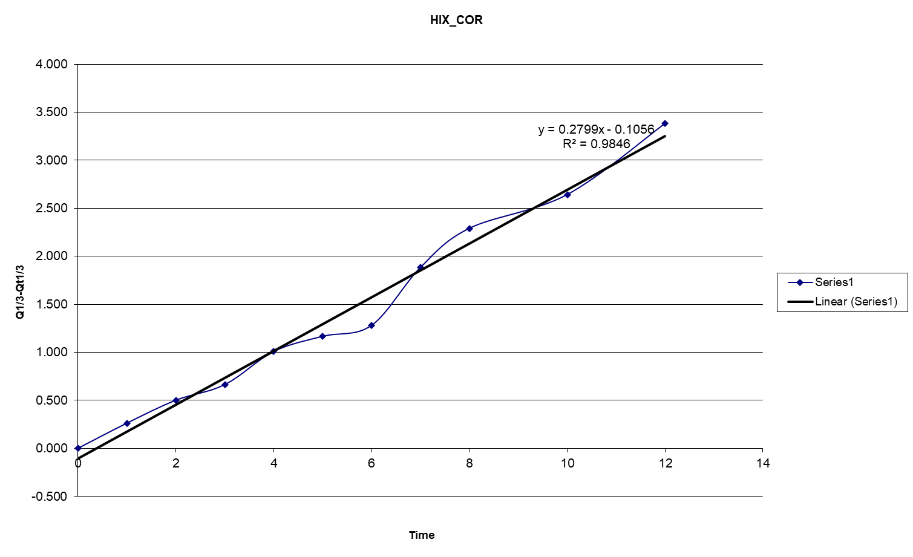
HIXON CROWELL
Time | Q 1/3-Qt 1/3
0 | 0.000
1 | 0.262
2 | 0.501
3 | 0.663
4 | 1.007
5 | 1.166
6 | 1.280
7 | 1.883
8 | 2.290
10 | 2.642
12 | 3.382
Hixon Crowell plot for optimized Formulation (F4)

Slide 28
Table :RELEASE KINETICS OF OPTIMISED FORMULATION OF R²VALUE
Formulation Code F4
ZERO | HIGUCHI | PEPPAS | Hixson Crowell
R(CvT) | R(CvRoot(T) | Log T vs Log C | TIME Vs (Q1/3-Qt1/3)
8.311 | 30.286 | 0.910 | 0.249
0.9925 | 0.9683 | 0.9967 | 0.9858
0.9850 | 0.9376 | 0.9934 | 0.9719
As n value is less than 1 , the optimized formulation follows non-fickian diffusion model. To find the n value the above kinetic models were used.

Slide 29
CONCLUSION
A new sustained-release system of drug-entrapped sodium alginate beads was formulated by an ion gelation method. the beads were designed by different excipients like HPMC, egg albumin, tween-80, and sodium alginate along with the drug.
Different evaluation tests are performed like FTIR studies, swelling index, drug content, bead size measurement, and in-vitro dissolution studies. All the results obtained from the tests are correlated with the limits and were found to be within the range. Its morphological and release characteristics were studied.
The beads were easy to prepare and the mean diameter of beads increased with the effect of the amount of sodium alginate and HPMC. From the proposed study, the F4 formulation was found to have drug content, swelling index and bead size, and high dissolution rate. The total drug release from F4 formulation in p^{H} 6.8 phosphate buffer (dissolution medium) was found to be 98% drug release. Among different Formulations, F4 has shown a high dissolution rate effect.
The beads showed excellent sustaining properties as compared to the conventional beads. Thus, the ion gelation technique appears to be a useful tool for the development of multi-particulate systems even for a water-soluble drug.

Slide 30
REFERENCES
1) Suryakanta Swain1 *, Aurobinda Behera, Sarwar Beg1, Chinam N. Patra, Subash C. Dinda2, Jammula Sruti1,and Muddana E. B. Rao1, "Modified Alginate Beads for Mucoadhesive Drug Delivery System: An Updated Review of Patents", Recent Patents on Drug Delivery & Formulation 2012, 6, 259-277.
2) Khan, Ismail, & Gani, "Recent Development in Sustained-Release Beads" International Journal of Researchin Pharmaceutical Sciences, 27 Jan 2020.
3) Suryakanta Swain1 *, Aurobinda Behera, Sarwar Beg1, Chinam N. Patra, Subash C. Dinda2, Jammula Sruti1,and Muddana E. B. Rao1, "Modified Alginate Beads for Mucoadhesive Drug Delivery System: An Updated Review of Patents", Recent Patents on Drug Delivery & Formulation 2012, 6, 259-277.
4) Engyel M, Kállai-Szabó N, Antal V, Laki AJ, Antal I. Microparticles, particulate spheres, and microbeads for advanced drug delivery. Sci Pharm. 2019; 87 (3)
5). DAS MK, AHMED AB, SAHA D.Particulate spheres a Drug Delivery System Review. Int J Curr PharmRes.2019; 34–41.
6) Khan, Ismail, & Gani, "Recent Development in Sustained-Release Beads" International Journal of Researchin Pharmaceutical Sciences, 27 Jan 2020.
8) Valluru Ravi *, T.M. Pramod Kumar1 and N. Rama Rao "Investigation of Ghatti Gum as a Carrier to develop
Polymeric Blend Beads of Galantamine Hydrobromide" International Journal of ChemTech Research CODEN
(USA): IJCRGG ISSN: 0974-4290 Vol.9, No.03 pp 482-490, 2016
.

Slide 31


